Slide 1
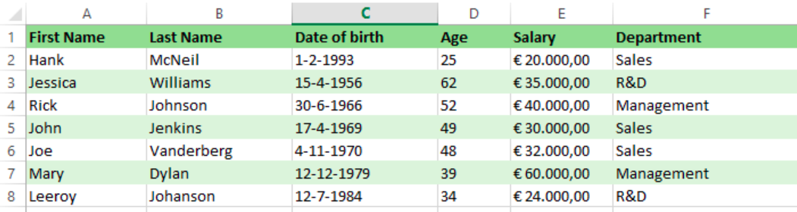
Correlated subquery primer
Get employees earning more than the average salary

Slide 2
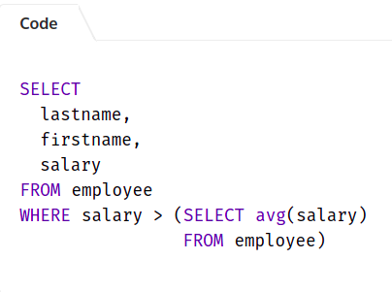
Simple subquery
Get employees earning more than the average salary

Slide 3
Simple subquery?
find all employees with a salary higher than their average departmental salary.

Slide 4
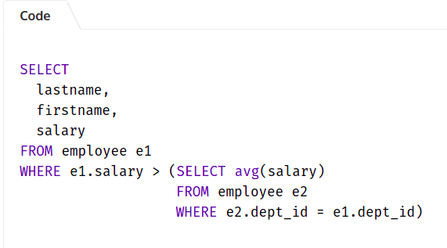
Simple subquery?
find all employees with a salary higher than their average departmental salary.

Slide 5
Simple vs correlated

Slide 6
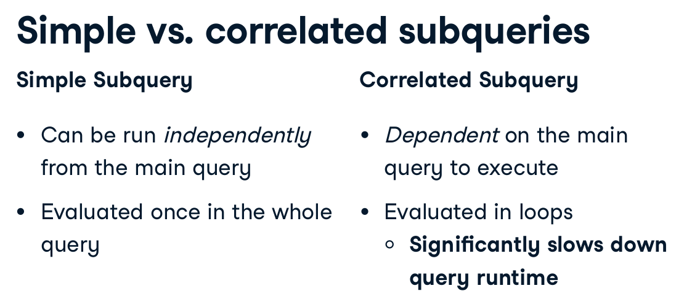
Correlated subqueries

Slide 7
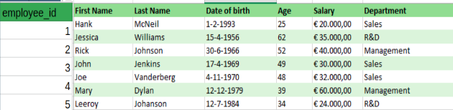
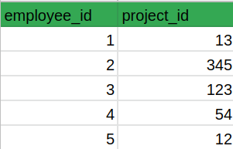
Find all employees not assigned a project
employee
assigned_to_project

Slide 8
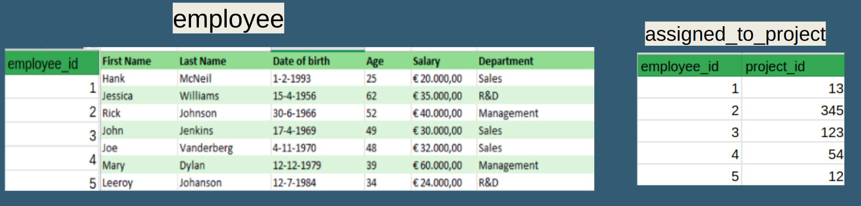
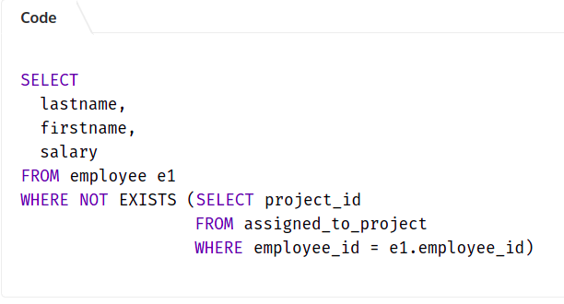
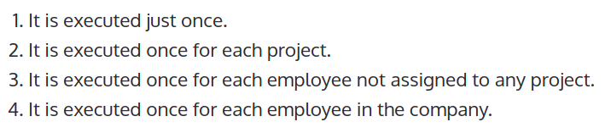
how many times the SQL correlated subquery is executed?

Slide 9
how many times the SQL correlated subquery is executed?

Slide 10
When can we avoid?
find all employees with a salary higher than their average departmental salary.
Window functions

Slide 11
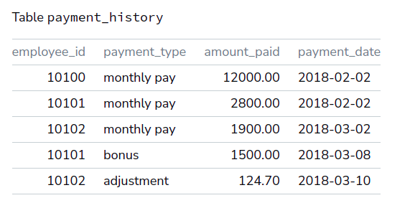
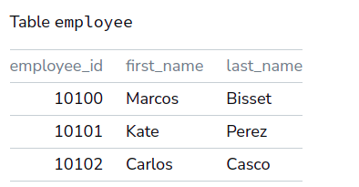
What solutions are available?
List the employees who have never received a bonus.

Slide 12
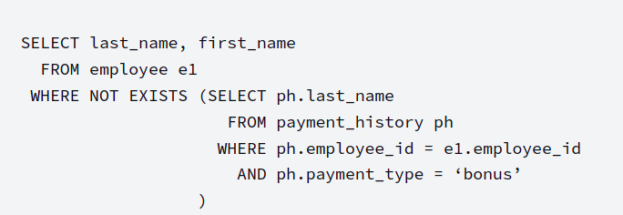
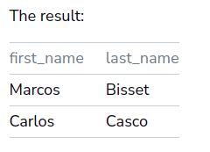
Correlated Subquery
List the employees who have never received a bonus.
EXIST WITH SUBQ - FAST TO
THE POINT

Slide 13
Common use cases for correlated subqueries
find all employees who are not assigned to any projects
List the employees who have never received a bonus.
ANYTHING COMMON?

Slide 14
Common use cases for correlated subqueries
find all employees who are not assigned to any projects
List the employees who have never received a bonus.
ANYTHING COMMON?
NEGATIVES!

Slide 15
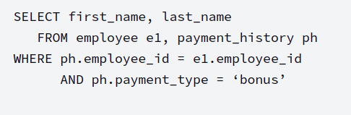
What About Positive Data Questions?
List the employees who have received a bonus.
وديتوا الجوين فيين ؟

Slide 16
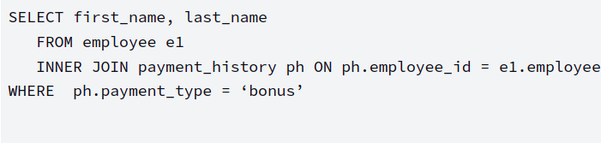
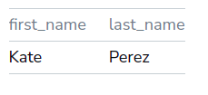
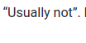
Implicit join :)
Performance difference?
USE JOIN instead of a correlated subquery whenever possible.

Slide 17
Even this, I believe can be solved with window functions
SELECT first_name, last_name
FROM employee e1, payment_history ph
WHERE e1.employee_id = ph.employee_id
AND amount_paid > = (
SELECT avg(amount_paid)
FROM payment_histoty ph2
WHERE ph2.employee_id = e1.employee_id
AND ph2.payment_date < ‘2018-03-01’
)
AND month(ph.payment_date) = 3
AND year(ph.payment_date) = 2018
AND ph.payment_type = ‘salary’

Slide 18

MORE INFO
https://bipp.io/sql-tutorial/advanced-sql/sql-correlated-subqueries/

Slide 19

More info
https://learnsql.com/blog/correlated-sql-subqueries-newbies/

Slide 20
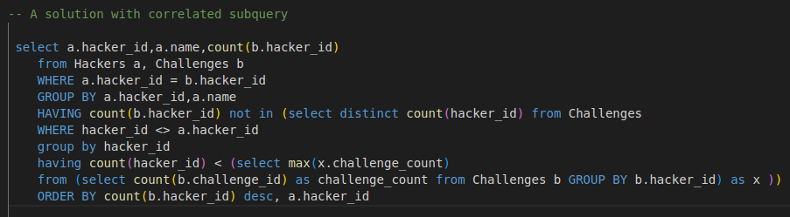
Hackerrank problem
https://www.hackerrank.com/challenges/challenges/problem

Slide 21
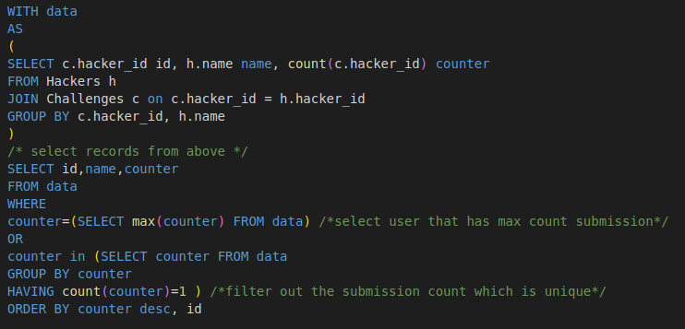
Solution
Further simplification
Notes:
use with clause again
or use window function

Slide 22
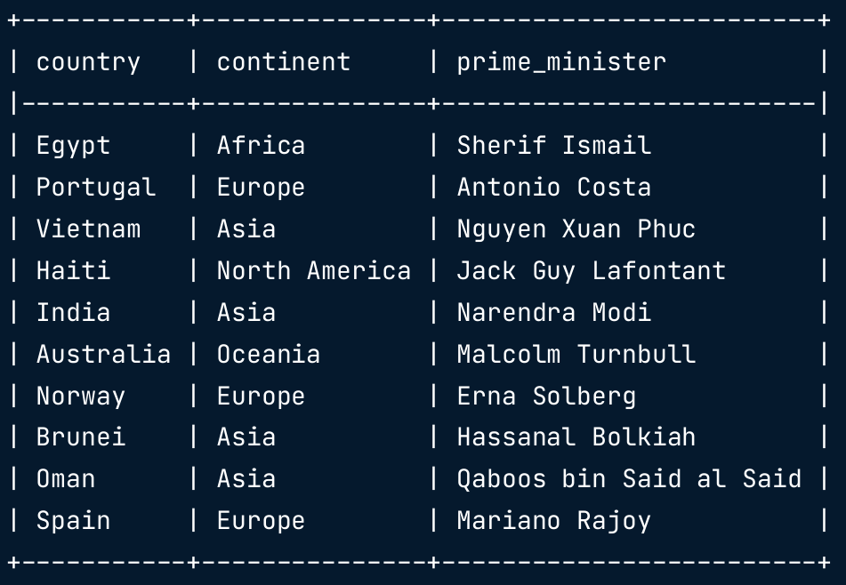
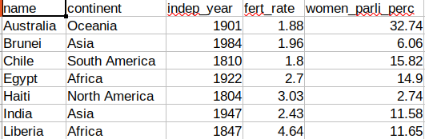
What about SELECT clause?
count the number of countries listed in the states table for each continent in the prime_ministers table

Slide 23
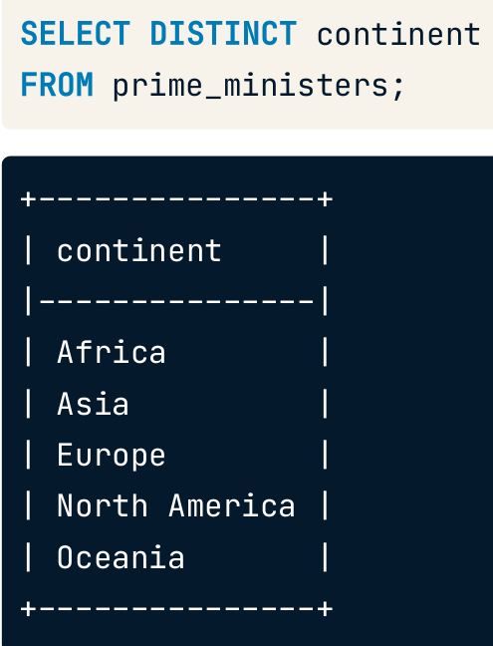
Step 1

Slide 24
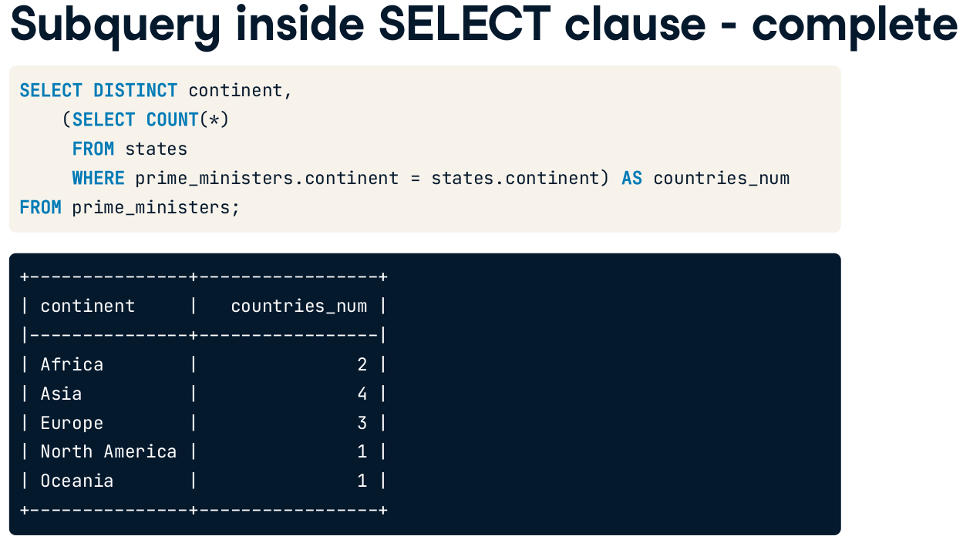
Finishing step?
Are the queries related?
Outcome of inner query?
Notes:
array

Slide 25
Finishing step?
Notes:
array

Slide 26
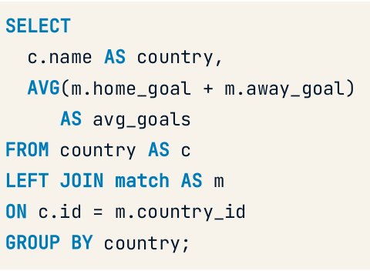
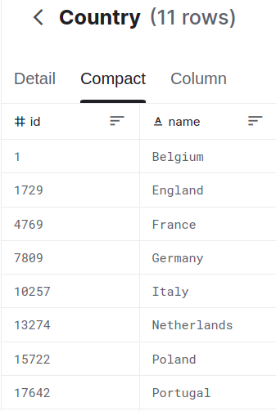
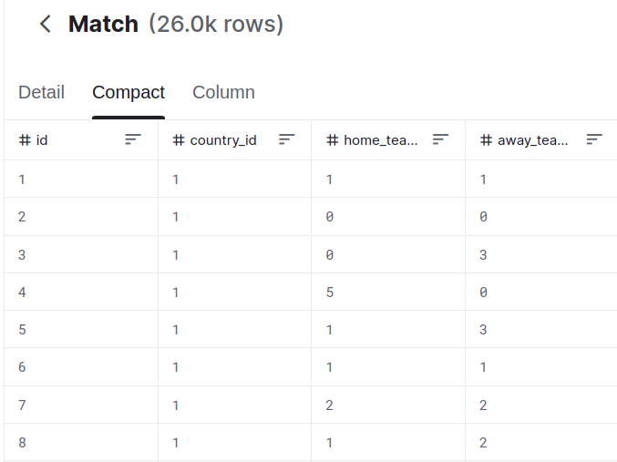
Convert to correlated
What is the average number of goals scored in each country?

Slide 27
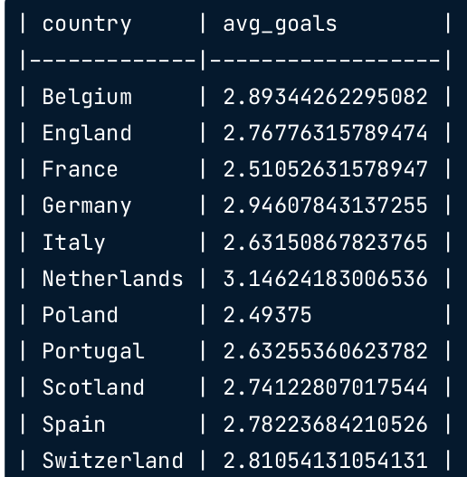
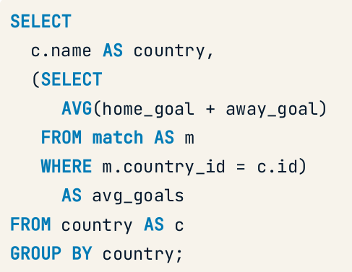
Convert to correlated
What is the average number of goals scored in each country?
How is avg in inner query and the group by in outer query?
Notes:
Inner correlated query is evaluated once for every row of outer query. Thus it benefits from the outside group by. Ana ba5amen

Slide 28
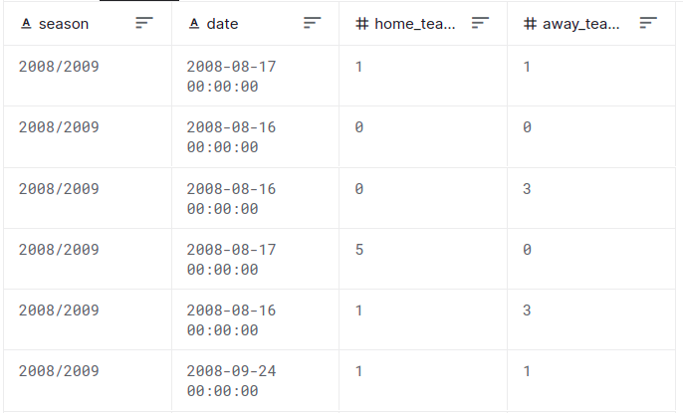
Nested subqueries
How does each month's total goals differ from the average monthly total of goals scored?
Mention the steps!

Slide 29
Nested subqueries
How does each month's total goals differ from the average monthly total goals scored?
1- get total goals by month
2- average them
3- get the difference
Mention the steps!

Slide 30
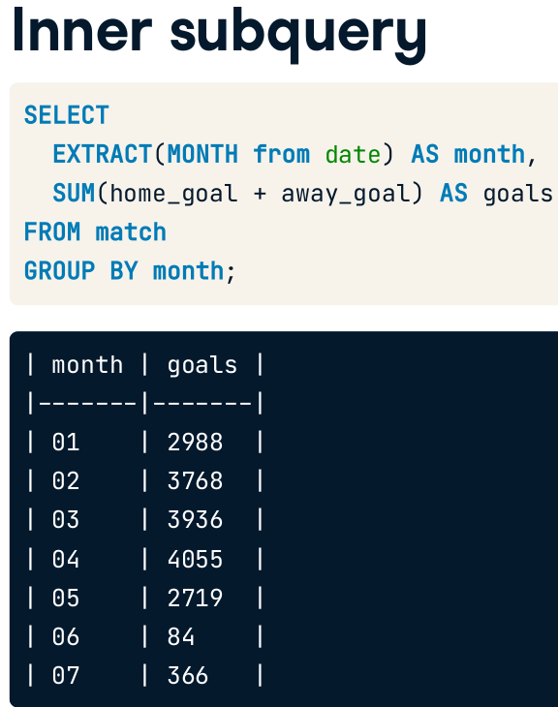
Nested subqueries
How does each month's total goals differ from the average monthly total of goals scored?
1- get total goals by month
2- average them
3- get the difference

Slide 31
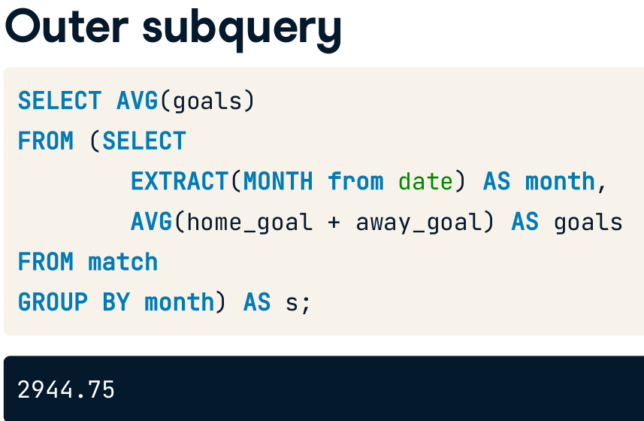
Nested subqueries
How does each month's total goals differ from the average monthly total of goals scored?
1- get total goals by month
2- average them
3- get the difference

Slide 32
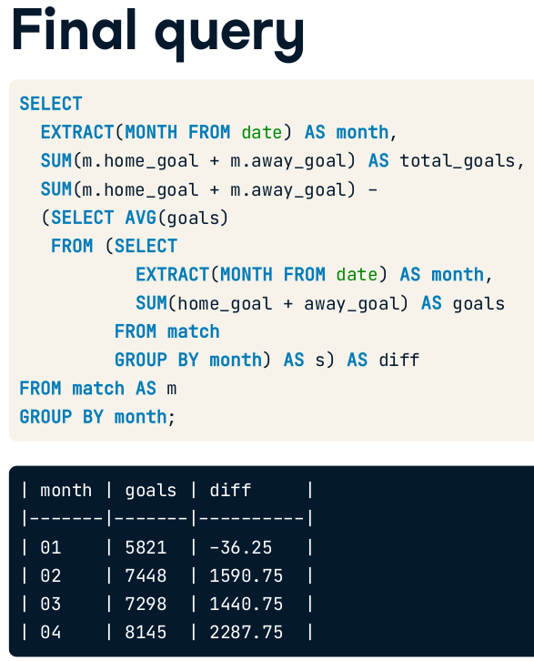
1- get total goals by month
2- average them
3- get the difference
Can we refactor?
Notes:
I think we can use with.
or we can use window functions
Maybe diff average can be converted to CTE ? Can we do this if it is scalar?
But can’t we make more than this

Slide 33
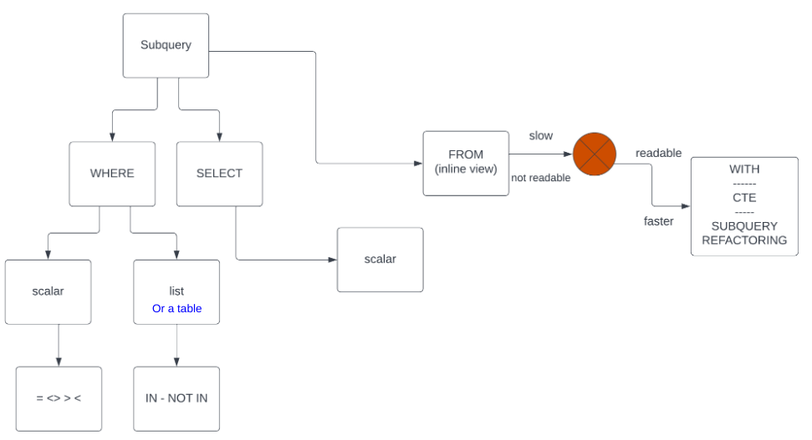
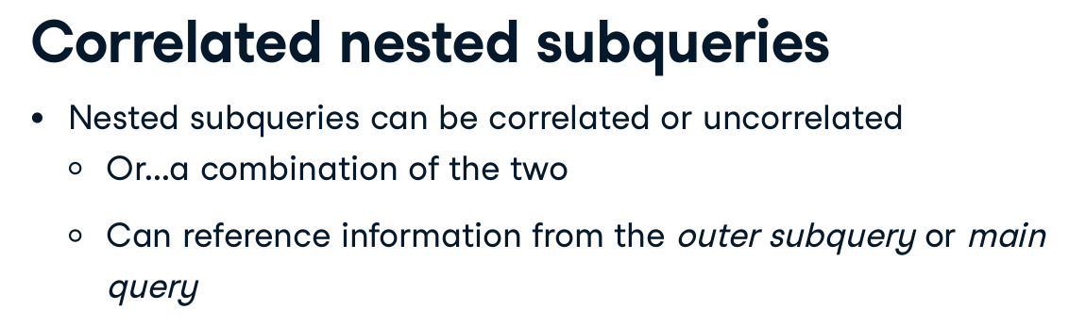
summary

Slide 34
CTE
The main advantage of the Common Table Expression (when not using it for recursive queries) is encapsulation, instead of having to declare the sub-query in every place you wish to use it, you are able to define it once, but have multiple references to it.
https://stackoverflow.com/questions/706972/difference-between-cte-and-subquery#:~:text=Adding%20to%20others'%20answers%2C%20if,to%20reuse%20your%20code%20better.

Slide 35
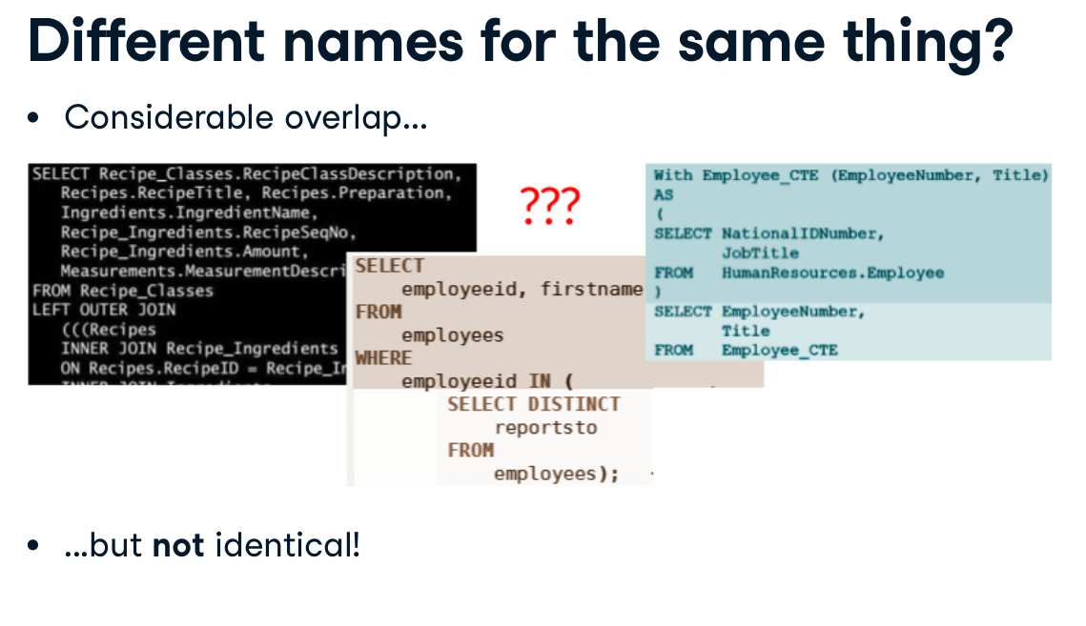

Slide 36
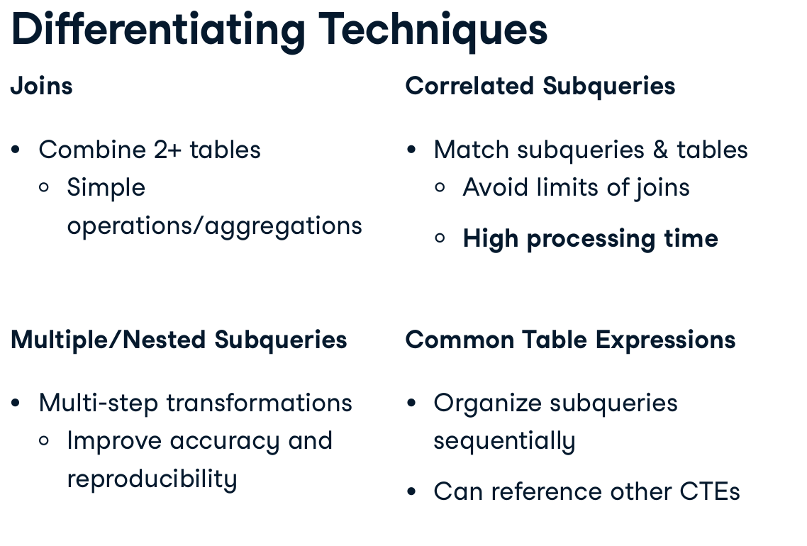
Recall the limits for the join, either from this course (match ) or from other previous slides (self join with duplicates)
Can CTE replace nested subqueries, if they can reference other CTEs and themselves?
Window functions, can they replace correlated subquery?

Slide 37
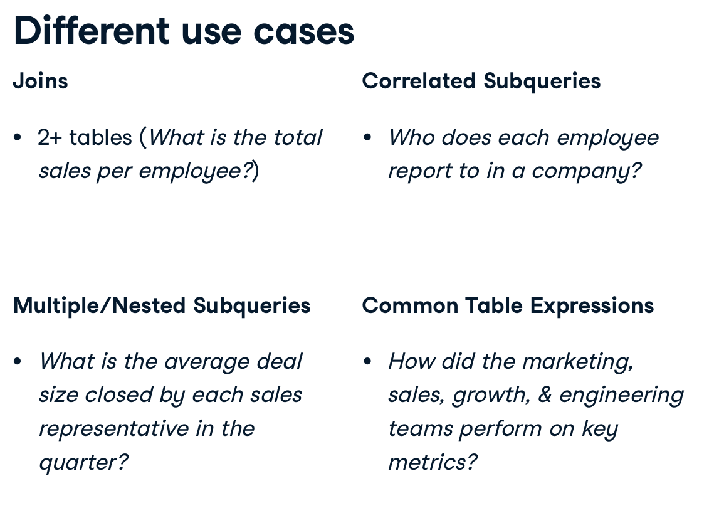

Slide 38
Challenge
https://campus.datacamp.com/courses/improving-query-performance-in-postgresql/bringing-together-the-data?ex=6
https://campus.datacamp.com/courses/improving-query-performance-in-postgresql/bringing-together-the-data?ex=7
https://campus.datacamp.com/courses/improving-query-performance-in-postgresql/bringing-together-the-data?ex=8

Slide 39

https://app.datacamp.com/learn/courses/improving-query-performance-in-postgresql

Slide 40
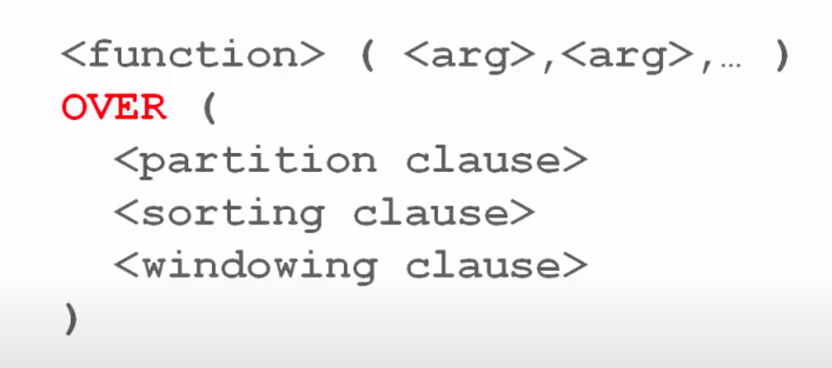
What about analytics/window functions?

Slide 41


Slide 42


Slide 43
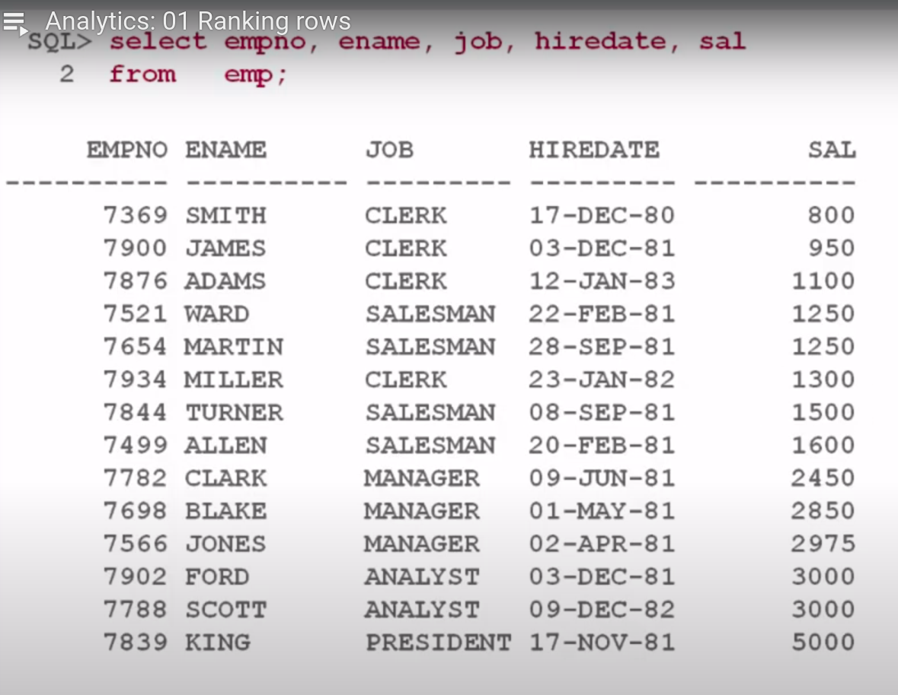

Slide 44
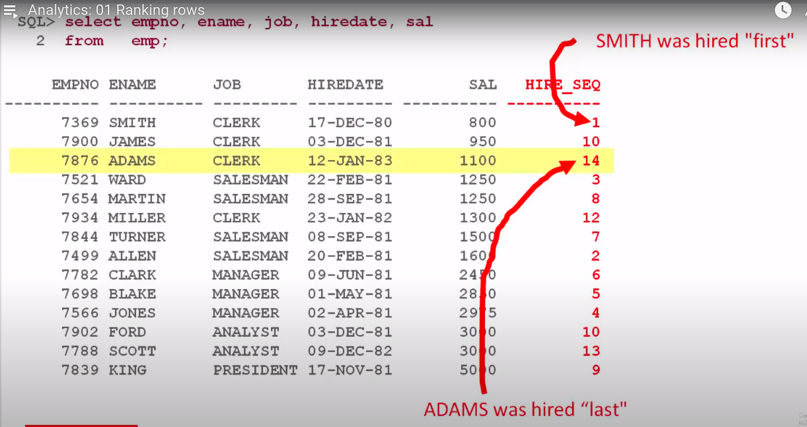
Expected output

Slide 45
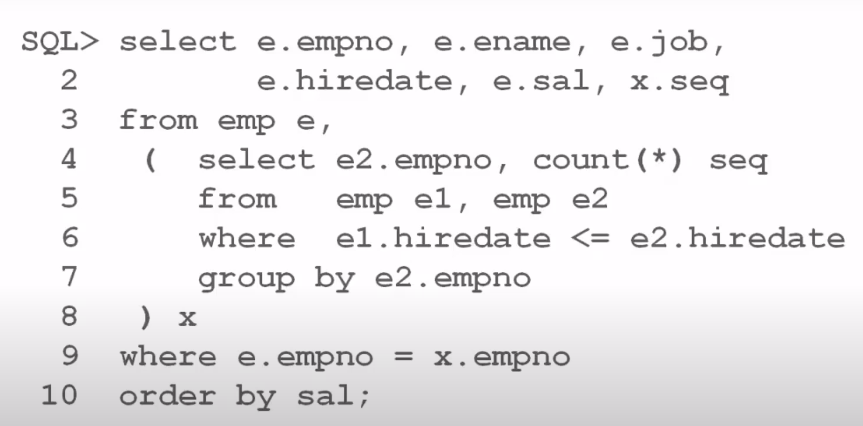

Slide 46
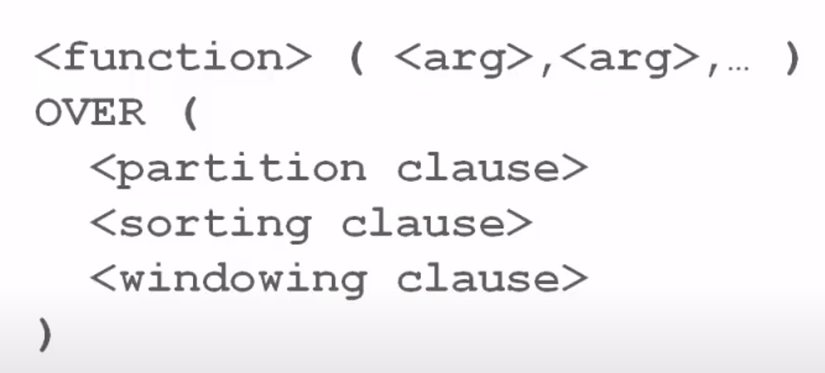
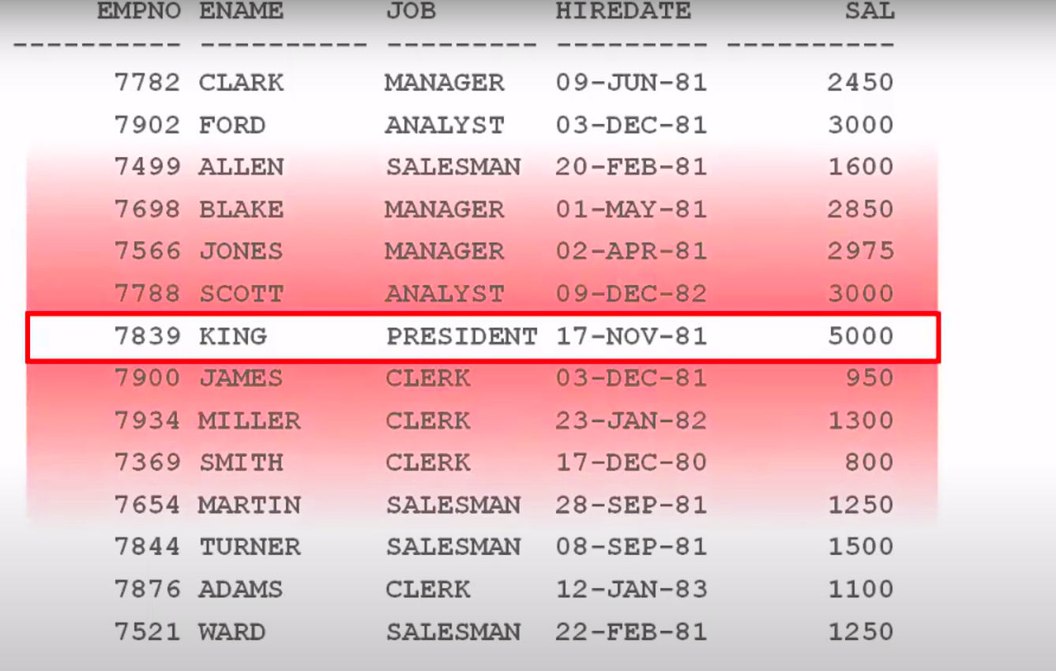
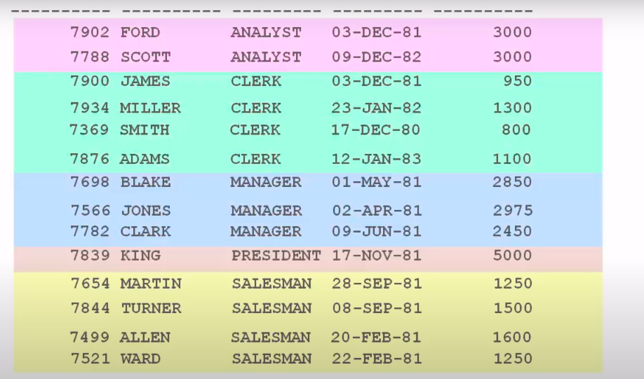


Slide 47
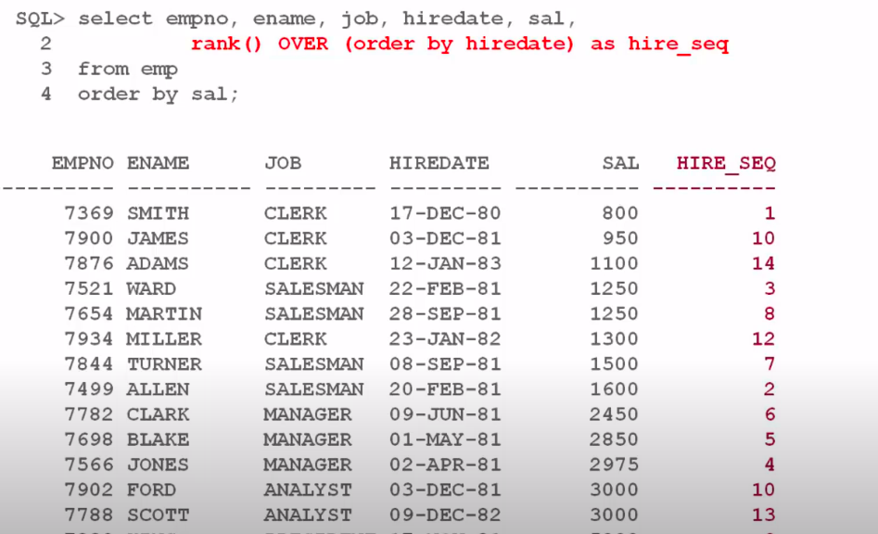

Slide 48
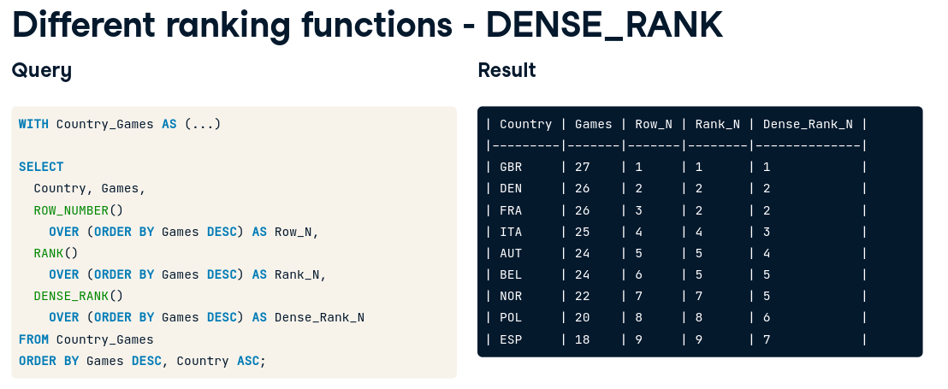
what’s the last rank for each column? [Row_N, RANK_N, DENSE_RANK_N]

Slide 49
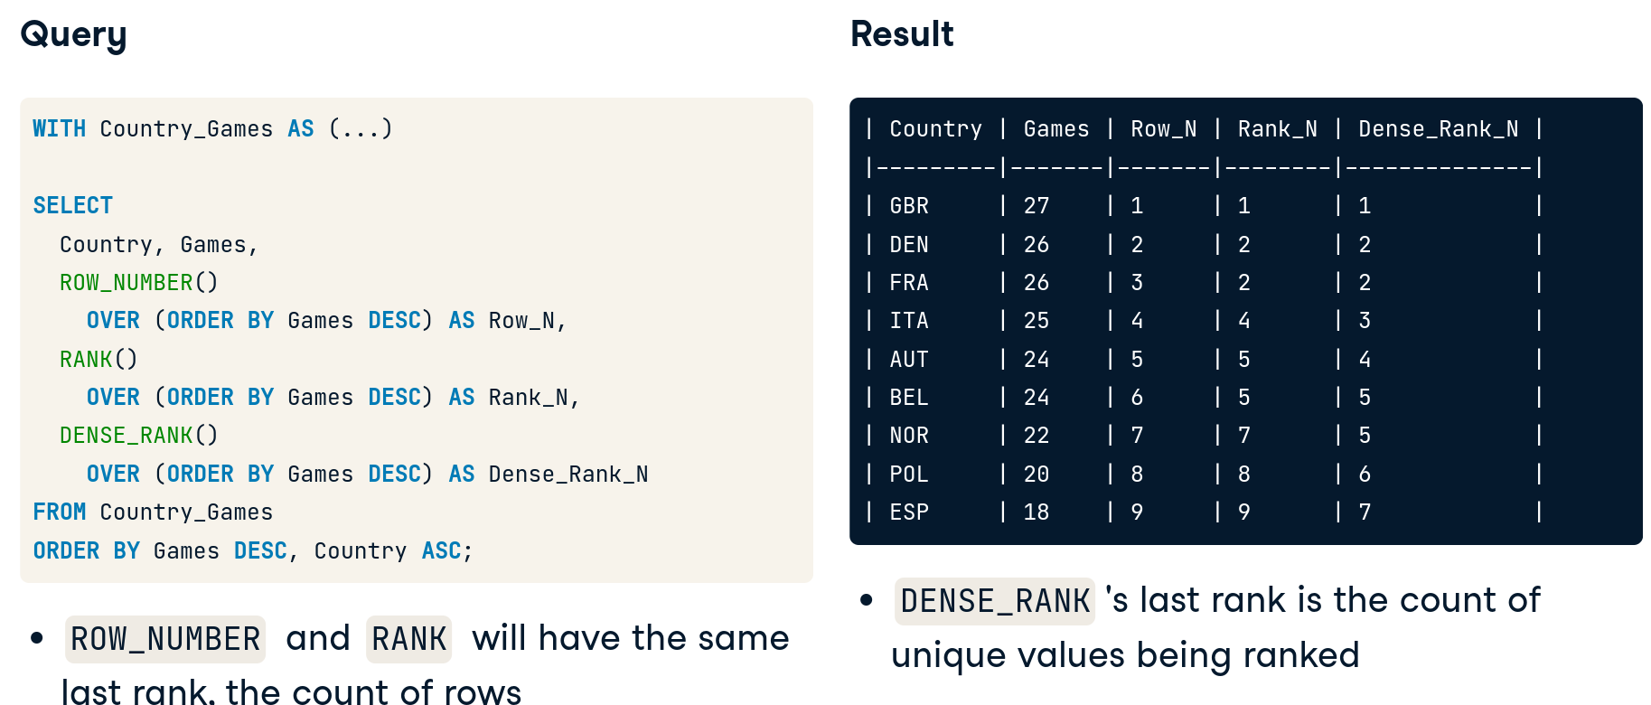

Slide 50
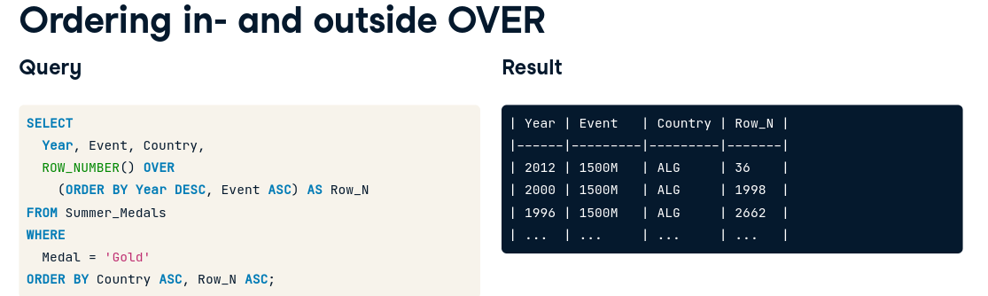

Slide 51
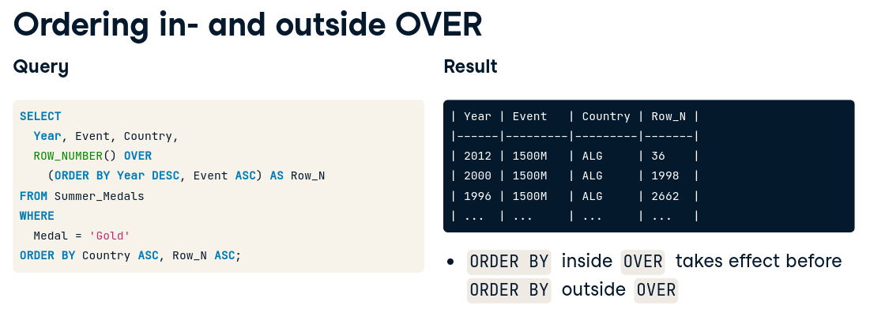

Slide 52
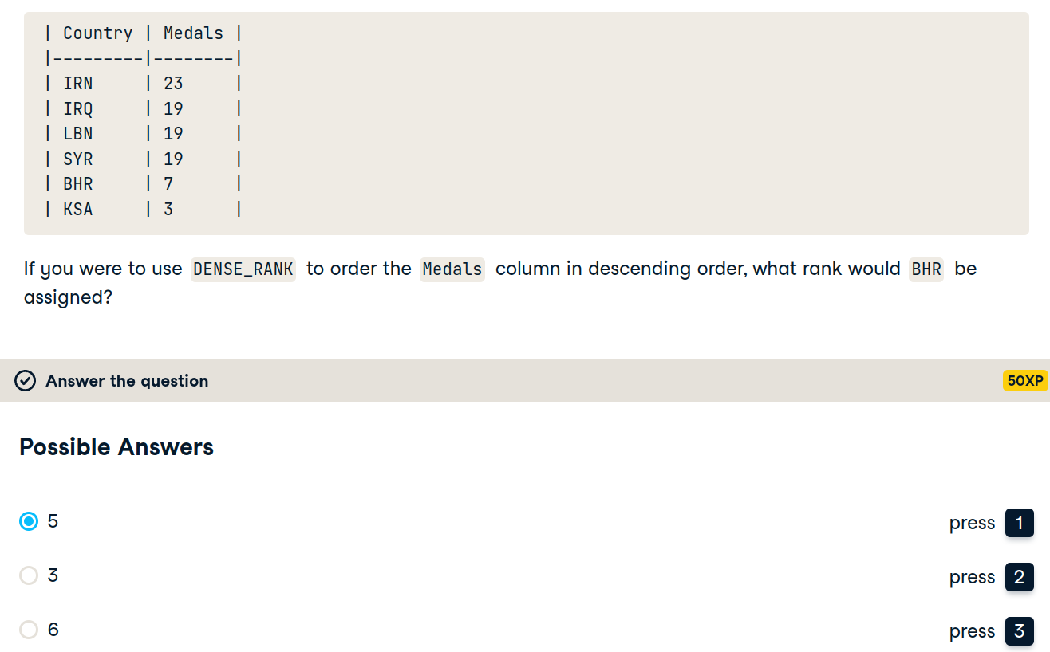

Slide 53


Slide 54



Slide 55


Macdonald’s

Slide 56


Slide 57


Notes:
I think that if u used the where clause, filtration will take place before the window function

Slide 58

https://www.youtube.com/watch?v=G2T2z0FVVgk&list=PLJMaoEWvHwFIUwMrF4HLnRksF0H8DHGtt&index=7

Slide 59


Slide 60


Running total

Slide 61

Partitioning effect

Slide 62

Notes:
PostgreSQL Window Functions: The Ultimate Guide
https://www.postgresqltutorial.com/postgresql-window-function/

Slide 63

Revisiting previous concepts

Slide 64


Automatic solution?
Can we do even better?
Notes:
window functions
COUNT(id) OVER() total_matches

Slide 65



Notes:
WITH clauses allow us to improve the structure of an SQL statement without polluting the database namespace.
As far as I understand, where is not possible.
SELECT is possible only with correlated subquery. (slow)
‹#›

Slide 66





https://www.youtube.com/watch?v=Gm8N_yip0Ek
Window function?
Notes:
The same result can be obtained with window SQL functions and just one CTE, but we used multiple common table expressions here.

Slide 67


Slide 68


Slide 69


Slide 70


Slide 71


Slide 72


Slide 73


Slide 74


Slide 75


Slide 76


Slide 77


Slide 78


Slide 79


Slide 80


Slide 81


Slide 82


Slide 83


Slide 84





SQL
Notes:
Preface | Learning SQL, 3rd Edition
https://learning.oreilly.com/library/view/learning-sql-3rd/9781492057604/preface01.html#learningsql-PREFACE-2-SECT-3
‹#›

Slide 85


MYSQL DATABASE GETTING STARTED
Notes:
MySQL :: Download MySQL Community Server
https://dev.mysql.com/downloads/mysql/
MySQL :: Other MySQL Documentation
https://dev.mysql.com/doc/index-other.html
MySQL Sandbox | mysql-db-sandbox | Katacoda
https://www.katacoda.com/mysql-db-sandbox/scenarios/mysql-sandbox
‹#›

Slide 86



Notes:
A subquery is always enclosed within parentheses, and it is usually executed prior to the containing statement. In udacity, they are saying “must be fully independent”
‹#›

Slide 87

TYPES OF SUBQUERIES
Notes:
‹#›

Slide 88
HOW TO USE?
Which operator to use?
Notes:
The type of result set returned by the subquery determines how it may be used and which operators the containing statement may use to interact with the data the subquery returns
When the containing statement has finished executing, the data returned by any subqueries is discarded, making a subquery act like a temporary table with statement scope (meaning that the server frees up any memory allocated to the subquery results after the SQL statement has finished execution).
‹#›

Slide 89


HOW MANY VALUES?
Notes:
How many values do we expect this inner query to yield? What about the outer query?
‹#›

Slide 90

SCALER (1 ROW 1 COLUMN)
Notes:
How many values do we expect this inner query to yield? What about the outer query?
‹#›

Slide 91
CAN WE GET THIS WITHOUT SUBQUERY?
Notes:
Order desc then limit 1
Or maybe self join -- we need to explore this self join
‹#›

Slide 92

WHAT ABOUT THE INNER QUERY?
Which operator can’t be used?
More on this later
Notes:
The subquery returns a single row with a single column, which allows it to be used as one of the expressions in an equality condition (if the subquery returned two or more rows, it could be compared to something but could not be equal to anything, but more on this later)
All operators can be used here
‹#›

Slide 93


REWRITE
Subquery vs hard coding
Notes:
The subquery is useful in this case because it allows you to retrieve information about the customer with the highest ID in a single query, rather than retrieving the maximum customer_id using one query and then writing a second query to retrieve the desired data from the customer table.
‹#›

Slide 94



SCALAR SUBQUERIES
Inequalities
Which query produces which result?
Notes:
noncorrelated subquery may be executed alone and does not reference anything from the containing statement. Most subqueries that you encounter will be of this type unless you are writing update or delete statements, which frequently make use of correlated subqueries
‹#›

Slide 95
SOLUTION
Inequalities
Notes:
noncorrelated subquery may be executed alone and does not reference anything from the containing statement. Most subqueries that you encounter will be of this type unless you are writing update or delete statements, which frequently make use of correlated subqueries
‹#›

Slide 96

CLARIFICATION
a single thing cannot be equated to a set of things.
Notes:
If you run the subquery by itself, you will see the following results:
‹#›

Slide 97
CLARIFICATION
a single thing cannot be equated to a set of things.
How to solve?
Notes:
If you run the subquery by itself, you will see the following results:
‹#›

Slide 98


MULTIPLE-ROW, SINGLE-COLUMN SUBQUERIES
Subquery vs hard coding?
Notes:
four additional operators that you can use to build conditions with these types of subqueries.
In
not in
All
Any
While the approach on the right seems reasonable when the set contains only two expressions, it is easy to see why a single condition using the in operator would be preferable if the set contained dozens (or hundreds, thousands, etc.) of values.
‹#›

Slide 99


MULTIPLE-ROW, SINGLE-COLUMN SUBQUERIES
IN NOT IN
Notes:
four additional operators that you can use to build conditions with these types of subqueries.
In
not in
All
Any
While the approach on the right seems reasonable when the set contains only two expressions, it is easy to see why a single condition using the in operator would be preferable if the set contained dozens (or hundreds, thousands, etc.) of values.
‹#›

Slide 100

WHAT’S THE OUTPUT?

Slide 101

WHAT’S THE OUTPUT?
Notes:
When using not in to compare a value to a set of values, you must be careful to ensure that the set of values does not contain a null value, because the server equates the value on the lefthand side of the expression to each member of the set, and any attempt to equate a value to null yields unknown
‹#›

Slide 102


ALL VS ANY
Notes:
The subquery in this example returns the total number of film rentals for all customers in North America, and the containing query returns all customers whose total number of film rentals exceeds any of the North American customers.
The subquery returns the total film rental fees for all customers in Bolivia, Paraguay, and Chile, and the containing query returns all customers who outspent at least one of these three countries (if you find yourself outspending an entire country, perhaps you need to cancel your Netflix subscription and book a trip to Bolivia, Paraguay, or Chile...).
‹#›

Slide 103

هجرة ؟؟

Slide 104
MULTICOLUMN SUBQUERIES
Revisit in book

Slide 105

CORRELATED SUBQUERIES
How does it work?
Notes:
Unlike a noncorrelated subquery, a correlated subquery is not executed once prior to execution of the containing statement; instead, the correlated subquery is executed once for each candidate row (rows that might be included in the final results)
For example, the following query uses a correlated subquery to count the number of film rentals for each customer, and the containing query then retrieves those customers who have rented exactly 20 films:
The reference to c.customer_id at the very end of the subquery is what makes the subquery correlated; the containing query must supply values for c.customer_id for the subquery to execute.
The containing query retrieves all 599 rows from the customer table and executes the subquery once for each customer, passing in the appropriate customer ID for each execution. If the subquery returns the value 20, then the filter condition is met, and the row is added to the result set.
‹#›

Slide 106
CORRELATED SUBQUERIES
What affects the speed of the query ?
Number of rows in customer table
Notes:
Unlike a noncorrelated subquery, a correlated subquery is not executed once prior to execution of the containing statement; instead, the correlated subquery is executed once for each candidate row (rows that might be included in the final results)
For example, the following query uses a correlated subquery to count the number of film rentals for each customer, and the containing query then retrieves those customers who have rented exactly 20 films:
The reference to c.customer_id at the very end of the subquery is what makes the subquery correlated; the containing query must supply values for c.customer_id for the subquery to execute.
The containing query retrieves all 599 rows from the customer table and executes the subquery once for each customer, passing in the appropriate customer ID for each execution. If the subquery returns the value 20, then the filter condition is met, and the row is added to the result set.
‹#›

Slide 107


THE EXISTS OPERATOR
Which one would work?
Notes:
While you will often see correlated subqueries used in equality and range conditions, the most common operator used to build conditions that utilize correlated subqueries is the exists operator. You use the exists operator when you want to identify that a relationship exists without regard for the quantity; for example, the following query finds all the customers who rented at least one film prior to May 25, 2005, without regard for how many films were rented:
If you look at the select clause of the subquery, you will see that it consists of a single literal (1); since the condition in the containing query only needs to know how many rows have been returned, the actual data the subquery returned is irrelevant. Your subquery can return whatever strikes your fancy, as demonstrated next:
‹#›

Slide 108

SOLUTION
Both
Notes:
While you will often see correlated subqueries used in equality and range conditions, the most common operator used to build conditions that utilize correlated subqueries is the exists operator. You use the exists operator when you want to identify that a relationship exists without regard for the quantity; for example, the following query finds all the customers who rented at least one film prior to May 25, 2005, without regard for how many films were rented:
If you look at the select clause of the subquery, you will see that it consists of a single literal (1); since the condition in the containing query only needs to know how many rows have been returned, the actual data the subquery returned is irrelevant. Your subquery can return whatever strikes your fancy, as demonstrated next:
However, the convention is to specify either select 1 or select * when using exists
‹#›

Slide 109

ACTORS NEVER IN R-RATED FILMS

Slide 110
WHEN TO USE SUBQUERIES

Slide 111

SUBQUERY TYPES
Notes:
some subqueries are completely self-contained (called noncorrelated subqueries), while others reference columns from the containing statement (called correlated subqueries).
‹#›

Slide 112
PITFALLS
Exercise 1
Maybe 3
5 and 6 and 7
Notes:
some subqueries are completely self-contained (called noncorrelated subqueries), while others reference columns from the containing statement (called correlated subqueries).
‹#›

Slide 113

Want more info?
https://www.red-gate.com/simple-talk/databases/sql-server/t-sql-programming-sql-server/ten-common-sql-programming-mistakes/

Slide 114
Demo
subqueries_video_sql_scripts.sql in demo folder

Slide 115

Breakout rooms
https://projects.datacamp.com/projects/1413
Prerequisites:
1- Joins
2- Set theory
3- Subqueries

Slide 116
Udacity project
Digital Music Store Database
Solved example project: [Parch and Posey Data]

Slide 117


Slide 118

4 questions

Slide 119

https://codebeautify.org/sqlformatter

Slide 120


Help is there!

